Slide 1
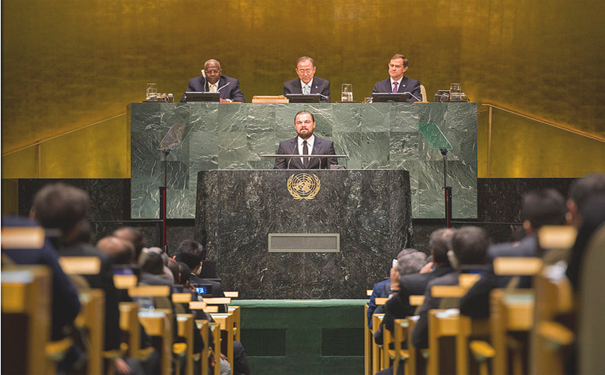
the question
Notes:
How can digital innovation help the UN and the public work more effectively together?
We decided to use digital to tackle an issue right at the heart of the UN.

Slide 2
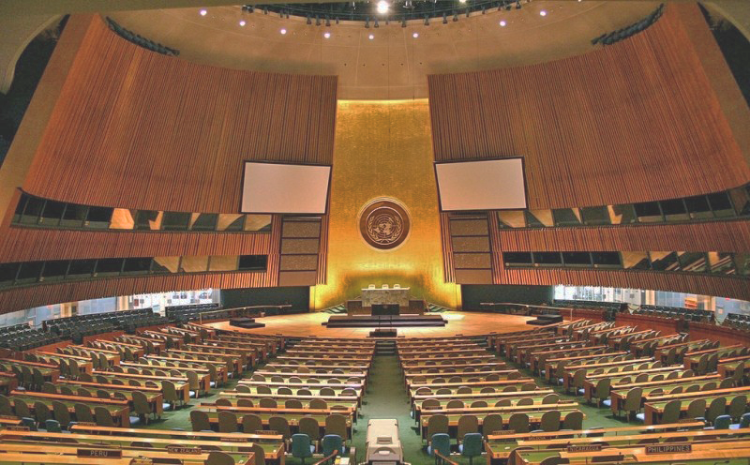

we the peoples
Notes:
The UN Secretary-General plays a crucial role in tackling global challenges and improving the lives of seven billion people but they are chosen behind closed doors by the permanent 5 members of the security councils. It's not democratic, it's not in keeping with the Charter of the UN and the idea of "We The Peoples”

Slide 3


Notes:
"We support the 1 for 7 Billion campaign. With a reach of 500k twitter followers and coverage in the New York Post and beyond, we have a highly engaged users, waiting to take actions beyond petition signing and that’s why we’ve designed wethepeoples.co;
I’m Dan Marsh, the ideator for wethepeoples and I’m joined on stage with Zack the lead developer and Jo Mitchell a fellow ideator

Slide 4
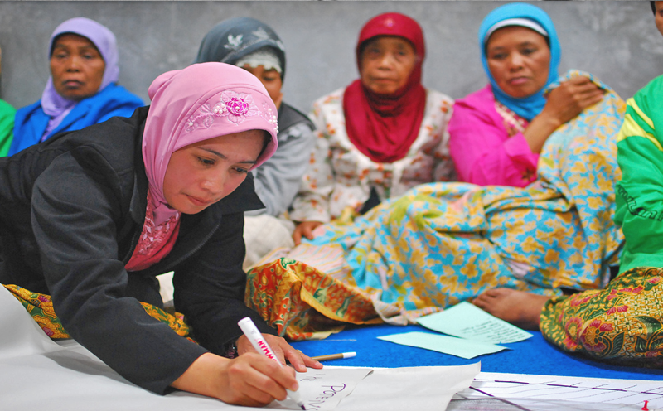
first steps for change
Notes:
'WeThePeoples gives anyone a chance to suggest their own candidate for SG and critically, to then campaign for that person on Facebook, YouTube, Twitter and other networks. We will regularly contact nominators and voters to tell them how their nominee is fairing and give them advice on how to help spread the campaign message. This will in turn raise the profile of the site, which in turn will help raises the real issue of how crazy the way of choosing the Sec-Gen this is."

Slide 5

simple and engaging
Notes:
The system was designed with simplicity in mind, able to be used by anyone from a 70 year old member of their local UN Association to a teenager who has previously had no interest in the UN or indeed someone in a UN supported country with only SMS access to the web.

Slide 6

demo
Notes:
I’ll now hand over to Zack to demo where we are right now:

Slide 7
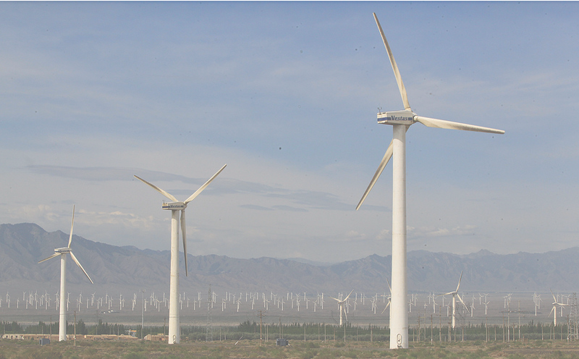
moving forward
Notes:
We have an (almost) launch ready project, a twitter account,@we_arethepeoples that has a massive 29 followers and increasing. We will work with UNA UK to ensure that we provide a voice for the seven billion.
Thanks for listening and are there any questions

